Slide 1
Arithmetic Functions
Reference: Moris Mano 4th Edition
Chapter 4

Slide 2
Arithmetic Functions
Binary Addition
Binary Multiplication
Binary Subtraction
BCD Addition

Slide 3

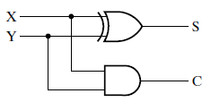
Half Adder
Adds two bits only
Input |  | Output
X | Y | S | C
0 | 0 | 0 | 0
0 | 1 | 1 | 0
1 | 0 | 1 | 0
1 | 1 | 0 | 1

Slide 4

Full Adder
Input |  |  | Output
X | Y | Z | S | C
0 | 0 | 0 | 0 | 0
0 | 0 | 1 | 1 | 0
0 | 1 | 0 | 1 | 0
0 | 1 | 1 | 0 | 1
1 | 0 | 0 | 1 | 0
1 | 0 | 1 | 0 | 1
1 | 1 | 0 | 0 | 1
1 | 1 | 1 | 1 | 1
Adds three bits only
After simplifying Sum-of-Minterms:

Slide 5
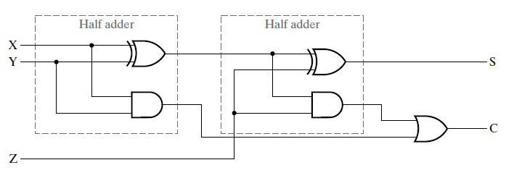
Full Adder
Logic Diagram of Full Adder

Slide 6
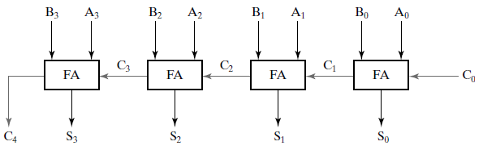
4-bit Ripple Carry Adder
4 – bit Ripple Carry Adder

Slide 7
4-bit Ripple Carry Adder

Slide 8

Binary Multiplier
Input |  | Output
A | B | R = A x B
0 | 0 | 0
0 | 1 | 0
1 | 0 | 0
1 | 1 | 1
R = A AND B

Slide 9
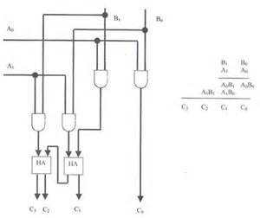
2-bit by 2-bit Multiplier

Slide 10
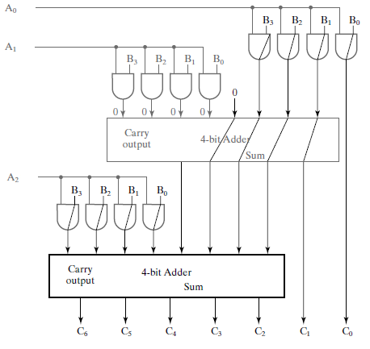
4-Bit by 3-Bit Binary Multiplier

Slide 11
Binary Adder-Subtractor

Slide 12
Binary Subtraction
(+A) – (+B) = (+A) + (-B)
(+A) – (-B) = (+A) + (+B)
(-A) – (+B) = (-A) + (-B)
(-A) – (-B) = (-A) + (+B)
Required
Actual Operation that we perform
Reason?

Slide 13
Binary Subtraction
A – B = A + (2’s Complement of B)
Arithmetic function which we perform is addition
2’s Complement of B = 1’s Complement of B + 1
A – B = A + (1’s Complement of B + 1)

Slide 14

Implementation of 1’s Complement
A0
Y0
A1
Y1
A2
Y2
.
.
.
An-1
Yn-1

Slide 15
XOR Operation
X | Y | F
0 | 0 | 0
0 | 1 | 1
1 | 0 | 1
1 | 1 | 0
Can we implement NOT operation using XOR?

Slide 16

XOR Operation
X | Y | F
0 | 0 | 0
0 | 1 | 1
1 | 0 | 1
1 | 1 | 0

Slide 17

XOR Operation
X | Y | F
0 | 0 | 0
0 | 1 | 1
1 | 0 | 1
1 | 1 | 0
X
X’
1
Can we implement 1’s Complement using XOR?

Slide 18
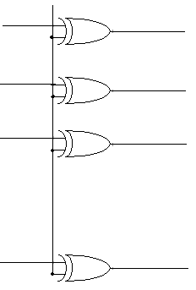
Implementation of 1’s Complement
1
A0
Y0
A1
Y1
A2
Y2
.
.
.
An-1
Yn-1

Slide 19
4-bit Ripple Carry Adder

Slide 20
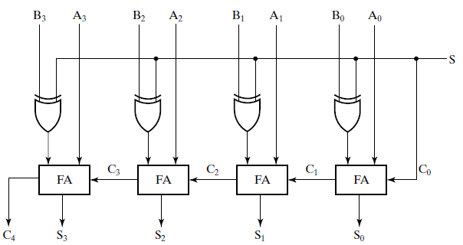
Adder-Subtractor Circuit (if S=0, act like an Adder) (if S=1, act like a Subtractor)
Selection
Input

Slide 21
Adder-Subtractor Circuit (if S=0, act like an Adder)
A = 0111 = +7
B = 0010 = +2
0
0
0
1
1
1
0
1
0
0
Selection
Input

Slide 22

Adder-Subtractor Circuit (if S=0, act like an Adder)
A = 0111 = +7
B = 0010 = +2
0
0
0
1
1
1
0
1
0
0
0
1
0
0
Selection
Input

Slide 23
Adder-Subtractor Circuit (if S=1, act like a subtractor)
A = 0111 = +7
B = 0010 = +2
0
0
0
1
1
1
0
1
1
1
1
0
1
1
Selection
Input

Slide 24
Overflow
When correct answer contains n+1 bits and we have only n bits to save result

Slide 25
BCD Addition

Slide 26
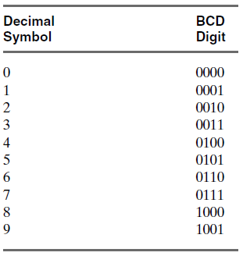
Binary Coded Decimal (BCD)

Slide 27
BCD (Contd.)
(396)10 = (?)BCD
( 3 9 6 )10
=( 0011 1001 0110 )BCD
=(001110010110)BCD

Slide 28
BCD (Contd.)
(110000101)BCD = (?)10
=( 0001 1000 0101 )BCD
=( 1 8 5 )10
=(185)10

Slide 29
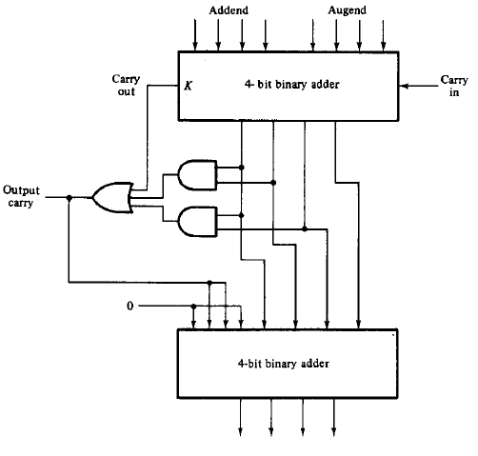
BCD Adder
Z3
Z2
Z1
Z0
C
S3
S2
S1
S0
BCD Sum

Slide 30
BCD Adder
<..1001..>
<..1000..>
1000
+1001
---------
0
Z3
Z2
Z1
Z0
C
S3
S2
S1
S0
BCD Sum

Slide 31
BCD Adder
1001
1000
1000
+1001
---------
10001
1
Z3
Z2
Z1
Z0
0001
C
S3
S2
S1
S0
BCD Sum

Slide 32
BCD Adder
1001
1000
1000
+1001
---------
10001
1
Z3
Z2
Z1
Z0
0
0
0
1
C
S3
S2
S1
S0
BCD Sum

Slide 33
BCD Adder
1001
1000
1000
+1001
---------
10001
1
Z3
Z2
Z1
Z0
Logic to check
If binary sum is
Greater than
9 (1001) or not
If sum is greater
Than 9 it will
Always produce
Carry
i.e.
(0001 0000)BCD = (10)10
(0001 0001)BCD = (11)10
(0001 0010)BCD = (12)10
C
S3
S2
S1
S0
BCD Sum
Carry

Slide 34
BCD Adder
Input |  |  |  | Output
Z3 | Z2 | Z1 | Z0 | C
0 | 0 | 0 | 0 | 0
0 | 0 | 0 | 1 | 0
0 | 0 | 1 | 0 | 0
0 | 0 | 1 | 1 | 0
0 | 1 | 0 | 0 | 0
0 | 1 | 0 | 1 | 0
0 | 1 | 1 | 0 | 0
0 | 1 | 1 | 1 | 0
1 | 0 | 0 | 0 | 0
1 | 0 | 0 | 1 | 0
1 | 0 | 1 | 0 | 1
1 | 0 | 1 | 1 | 1
1 | 1 | 0 | 0 | 1
1 | 1 | 0 | 1 | 1
1 | 1 | 1 | 0 | 1
1 | 1 | 1 | 1 | 1
C is function to check if binary
sum is greater than 9 (1001)
or not
If binary sum (Z3Z2Z1Z0)
is greater than 9 (1001) → C = 1
Else → C = 0
if binary sum > 1111
i.e. K = 1 (Carry produced in 1st
Adder) → C = 1

Slide 35
BCD Adder
Z1Z0
Z1’
Z1
Z3Z2
00
01
11
10
0 | 1 | 3 | 2
4 | 5 | 7 | 6
12 | 13 | 15 | 14
8 | 9 | 11 | 10
00
01
Z2
11
1
1
1
1
Z3
10
1
1
Z0
C = Z3Z2 + Z3Z1

Slide 36
BCD Adder
1001
1000
1000
+1001
---------
10001
1
Z3
Z2
Z1
Z0
Z3Z2
C = Z3Z2 + Z3Z1
Z3Z1
S3
S2
S1
S0
BCD Sum

Slide 37
BCD Adder
1001
1000
1000
+1001
---------
10001
1
Z3
Z2
Z1
Z0
Binary Sum is
greater than
1111
Z3Z2
C
Z3Z1
S3
S2
S1
S0
BCD Sum

Slide 38
BCD Adder
1001
1000
1000
+1001
---------
10001
1
Z3
Z2
Z1
Z0
C
1
S3
S2
S1
S0
BCD Sum

Slide 39
BCD Adder
1001
1000
1000
+1001
---------
10001
1
Z3
Z2
Z1
Z0
C
1
11
0110
S3
S2
S1
S0
BCD Sum

Slide 40
BCD Adder
1001
1000
1000
+1001
---------
10001
0001
+0110
---------
1
Z3
Z2
Z1
Z0
C
1
11
0110
0001
S3
S2
S1
S0
BCD Sum

Slide 41
BCD Adder
1001
1000
1000
+1001
---------
10001
0001
+0110
---------
0111
1
Z3
Z2
Z1
Z0
C
1
11
0110
0001
S3
S2
S1
S0
BCD Sum
0111

Slide 42
BCD Adder
0100
0100
1
0100
+0100
---------
1001
1
Z3
Z2
Z1
Z0
C
S3
S2
S1
S0
BCD Sum

Slide 43
BCD Adder
0100
0100
1
0100
+0100
---------
1001
1
Z3
Z2
Z1
Z0
0
1
0
0
1
C
S3
S2
S1
S0
BCD Sum

Slide 44
BCD Adder
0100
0100
1
0100
+0100
---------
1001
1
Z3
Z2
Z1
Z0
0
1
0
0
1
C
0
00
S3
S2
S1
S0
BCD Sum

Slide 45
BCD Adder
0100
0100
1
0100
+0100
---------
1001
1
Z3
Z2
Z1
Z0
0
1
0
0
1
C
0
00
0000
1001
S3
S2
S1
S0
BCD Sum
1001

Slide 46
Practice Problems
Design a high level logic diagram that executes following piece of code
if (X+Y < 10)
Z = X +Y+1
else
Z= X+Y

Slide 47
Practice Problems
Design a high level logic diagram that executes following piece of code
F(x,y) = if (3x>4y)
2x+5y
Else
2x - y

